Slide 1
Division of Motor Vehicles Military Plates Presentation United Veterans Committee of Colorado April 14, 2015

Slide 2
United Veterans Committee of Colorado Agenda
State of Colorado Military License Plates
Free First Time Issuance Military License Plates
Requirements for Issuance of a Free First Time Issuance Disabled Veteran and Disabled Veteran Handicap Military License Plate
Requirements for Issuance of a Free First Time Issuance Other Military License Plate
Current Process for Qualified Individuals for Issuance of a Free First Time Issuance Military License Plate
Challenges with the Current Process
New Initiative with El Paso, Arapahoe and La Plata Counties

Slide 3
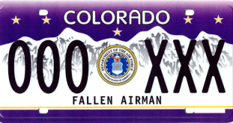
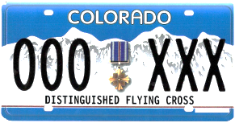
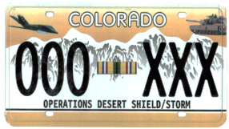
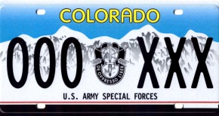
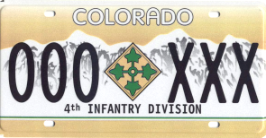
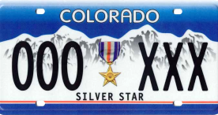
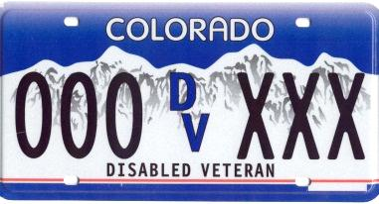
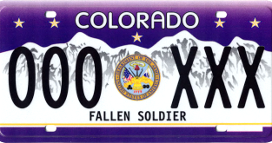
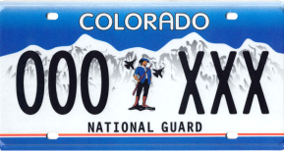
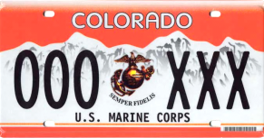
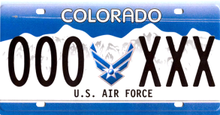
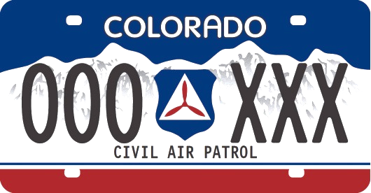
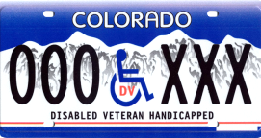
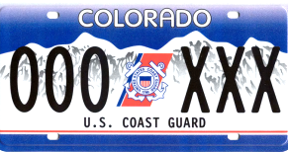
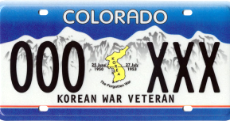
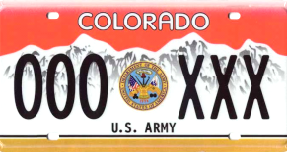
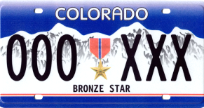
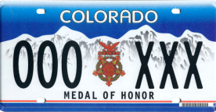
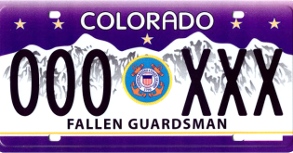
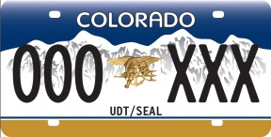
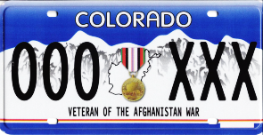
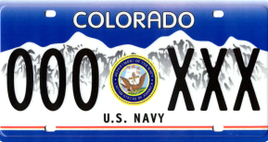
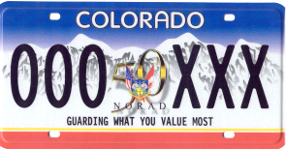
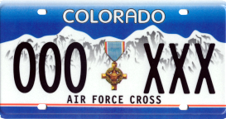
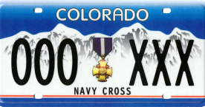
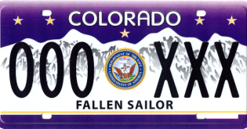
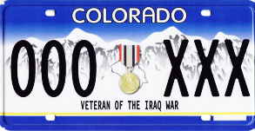
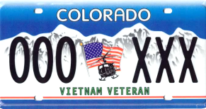
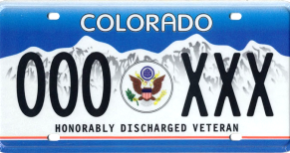
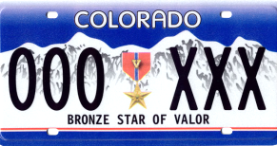
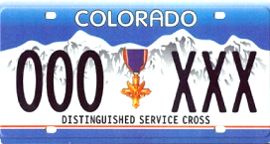
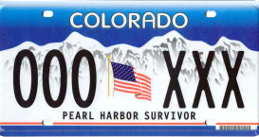
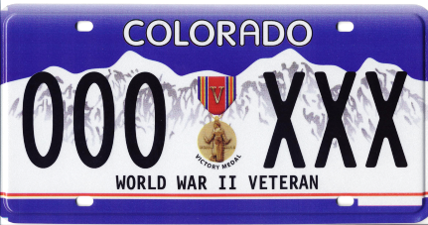
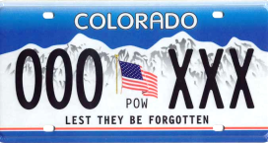
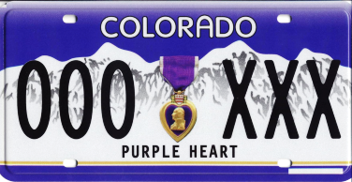
State of Colorado Military License Plates - 38

Slide 4
Free First Time Issuance License Plates - 11
Free first time issued military special license plates are exempt all taxes and fees pursuant to C.R.S
42-3-104(5), (6) and (8); 42-3-213(1)(b)(II)(A), (B), (C), (D), (E), (F) and (I); 42-3-301(2)(b); and 42-3-204(3)(a), (d), (e), (f), (g) and (h)

Slide 5
Requirements for Issuance of a Free First Time Issuance Disabled Veteran Military License Plate
Must meet ONE of the following*:
Permanent service connected disability rated at 50% or more, or
Loss or permanent loss of use of one or both feet, or
Loss or permanent loss of use of one or both hands, or
Loss of sight in both eyes
*Colorado Revised Statutes 42-3-304(3)(a)
Verification of the qualifications need to be in writing from
The Veterans Administration, or
The branch of service (on Official Military Stationary) from which their compensation is received
Letter needs to state that the individual has a permanent service connected disability rated at 50% or more
Honorable discharge from a branch of the Armed Services of the United States
Copy of DD 214 or other discharge documents issued by the Armed Services of the United States

Slide 6
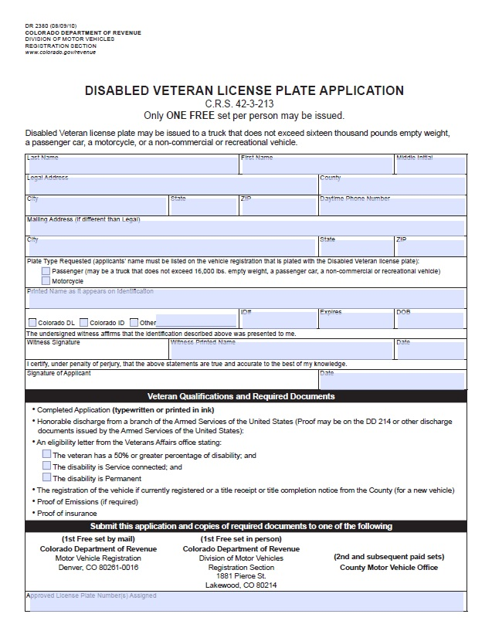
Current Process for Qualified Individuals for Issuance of a Free First Time Issuance Disabled Veteran Military License Plate
Meet requirements listed in previous slide plus
Submit a completed DR 2380

Slide 7
Requirements for Issuance of a Free First Time Issuance Disabled Veteran Handicap Military License Plate
Meet the requirements to be issued and Disabled Veteran Military License Plate, and
*Colorado Revised Statutes 42-3-304(3)(a)
Meet the Person with Disabilities requirements
*Colorado Revised Statutes 42-3-213 (5)(a)(II)
Person with Disabilities requirement:
Persons With Disabilities must meet one of the criteria below and have it verified in writing by a medical professional*:
1) Mobility: Persons who cannot walk two-hundred feet without stopping to rest.
2) Assisted Mobility: Persons who cannot walk without the use of, or assistance from, a brace, cane, crutch, another person, prosthetic device, wheelchair, or other assistive device.
3) Respiratory: Persons who are restricted by lung disease to such an extent that the person’s forced (respiratory) expiratory volume for one second when measured by spirometry is less than one liter, or the arterial oxygen tension is less than sixty mm/hg on room air or at rest.
4) Oxygen: Persons who use portable oxygen.
5) Cardiac: Persons who have a cardiac condition to the extent that the person’s functional limitations are classified in severity as class III or IV according to the standards of the American Heart Association.
6) Other: Persons who are severely limited in their ability to walk due to an arthritic, neurological, or orthopedic condition.

Slide 8
Current Process for Qualified Individuals for Issuance of a Free First Time Issuance Disabled Veteran Handicap Military License Plate
Meet requirements listed in previous slide plus
Submit a completed DR 2380 and DR 2219

Slide 9
Requirements for Issuance of a Free First Time Issuance Other Military License Plate
Must meet the statutory requirements for the desired plate and submit appropriate application
See next slide
For a listing of requirements and to obtain the forms please visit www.Colorado.gov/revenue

Slide 10
Requirements for Issuance of a Free First Time Issuance Other Military License Plate
C.R.S. 42-3-213(7)
Form DR 2181
C.R.S. 42-3-213(10)
Form DR 2181
C.R.S. 42-3-213(10)
Form DR 2181
Copy of qualifying documents in lieu of the form
C.R.S. 42-3-213(25)
Form Not Required
C.R.S. 42-3-213(10)
Form DR 2181
C.R.S. 42-3-213(2)
Form DR 2223
C.R.S. 42-3-213(10)
Form DR 2181
C.R.S. 42-3-213(3)
Form DR 2502
C.R.S. 42-3-213(6)
Form DR 2130

Slide 11
Requirements for Issuance of a Free First Time Issuance Military License Plate
Ownership of the vehicle must be established in the county of residence of the applicant
One of the following needs to be provided
Vehicle title
Photo copy of vehicle title
Copy of the DR 2574 – title application
Copy of the registration receipt
Proof of current valid insurance
Proof of emissions compliance (if required)

Slide 12
Current Process for Qualified Individuals for Issuance of a Free First Time Issuance Military License Plate
Complete initial transactions by submitting required and application and documentation
By mail or fax to:
Department of Revenue, Vehicle Services Unit, P.O. Box 173350, Denver, CO 80214
Fax to: 303-205-5978
In person at Division of Motor Vehicles (DMV)
1881 Pierce St, Lakewood, CO 80214

Slide 13
Challenges with the Current Process
Regardless of where the individual lives the first free first time issuance plate transaction is completed at the Lakewood DMV office
Mail Transaction - if the application is incomplete, the application and supporting documents are returned via USPS to the customer
In Person Transaction – if the application is incomplete and customer is unable to provide missing required documents, the application is not processed and returned to the customer

Slide 14
New Initiative with El Paso, Arapahoe and La Plata Counties
El Paso, Arapahoe and La Plata Counties are issuing free first time issuance plates at County motor vehicle offices
Allows qualified individuals to obtain first time free issuance military plates from their county motor vehicle office
When fully implemented, there will no longer be a requirement to complete the first transaction at one State office

Slide 15
Contact Information
Mike Dixon – DMV Senior Director
michael.dixon@state.co.us
Tony Anderson – Title & Registration
Operations Director
anthonyj.anderson@state.co.us
Dylan Ikenouye – Title & Registration Administrative Services Manager
dylan.ikenouye@state.co.us

